Slide 1

Decision Theory Part II (Pt 1)
Chris Kiekintveld

Slide 2
Basic Decision Criteria
 | Forward Looking | Backwards Looking
Average Case | Maximize Expected Value | Minimize Expected Regret
Worst Case | Maximize Minimum Value | Minimize Maximum Regret

Slide 3
Further Considerations
Many other possible decision criteria
Normative rules with other properties
Descriptive rules that predict decisions
Behavioral economics/game theory/psychology try to predict human choices
Learning rules capture adaptation over repeated decisions
Optimization is used to make large scale/complex decisions

Slide 4
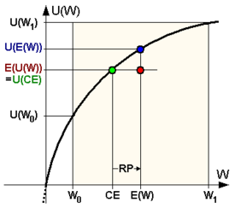
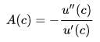
Risk Aversion
Prefer more certain outcomes to gambles
Humans often show forms of this
Curved utility functions
Arrow-Pratt measure of
absolute risk aversion:
Examples:
Logarithmic: u(c) = log(c)
Exponential: u(c) = 1-e^{(-ac)}

Slide 5
Risk Aversion: Bounded Loss
Another general approach optimizes the expected value subject to a maximum loss
Max loss must be lower than maxmin value
Why?
Tradeoff between higher average/worst case
Could optimize other objectives as well
Mathematical programming tools
Linear programming, mixed integer programming, nonlinear programming…

Slide 6
Ambiguity Aversion
“Risk” is often used to describe situations where probability information is available
“Ambiguity” refers to situations where probability information is unknown or uncertain
Decision makers may show a preference for well-defined problems rather than ambiguous ones
E.g. Dempster-Shafer Theory

Slide 7
Quantal Choice Models
Empirically, humans do not always choose the option with the maximum expected value
Insensitivity to small differences in value
Ambiguity in values
Overwhelmed by many/complex choices
Exploratory behavior
Mistakes
However, they do tend to choose higher valued actions more frequently

Slide 8
Quantal Choice
Estimates response frequency based on utility differences
Higher utilities are chosen more frequently
Equivalent to “noisy” utility values (with a certain distribution)
Quantal choice function:
λ: represents noise level or degree of rationality
0 = uniform random choices
∞ = approaches optimal (expected utility maximizing) choice
Notes:
qj : the probability that adversary takes pure strategy j
U(j,x): adversary’s expected utility by taking pure strategy j, given defender’s mixed-strategy x
λ: captures the rational level of the follower

